Slide 1

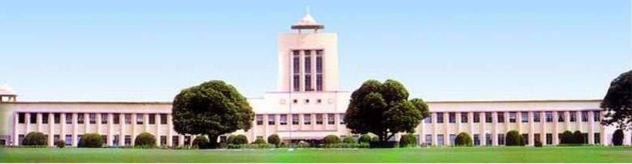
TEQIP III
Sponsored
One Week Workshop
on
Industrial Process Simulation
Registration Form
Organizing Committee
Name:____________________________
Designation:_______________________
Organization:______________________
Gender:___________________________
Educational Qualification: ___________
Address for correspondence:__________
_________________________________
_________________________________
Mobile No.:_______________________
Email Id:__________________________
Accommodation Required (Yes/No):
_________________________________
Experience:________________________
Details of Money Transfer:
Amount:___________________________
Number:___________________________
Date:______________________________
Date Signature of Applicant
Chief Guest
Prof. P.P. Chattopadhyay
Director, National Institute of Foundry and Forge Technology, Hatia ,Ranchi
16th - 20th May 2018
Patron
Prof. M.K. Mishra
Vice Chancellor, BIT, Mesra
Convener :
Prof. (Mrs.) S. Goswami (HOD)
Prof. Gautam Sarkhel
Chemical Engineering, BIT Mesra
Organizing Secretary:
Dr. Raghu Raja Pandiyan K.
Dr. Arnab Karmakar
Chemical Engg., BIT Mesra
Organized by
Department of
Chemical Engineering
Organizing Committe
Dr. Chandan Das
Dr. Bikash Kumar Mondal
Dr. Dan Bahadur Pal
Dr. Anand Bharti
BIRLA INSTITUTE OF TECHNOLOGY,
MESRA, RANCHI
https://www.bitmesra.ac.in

Slide 2
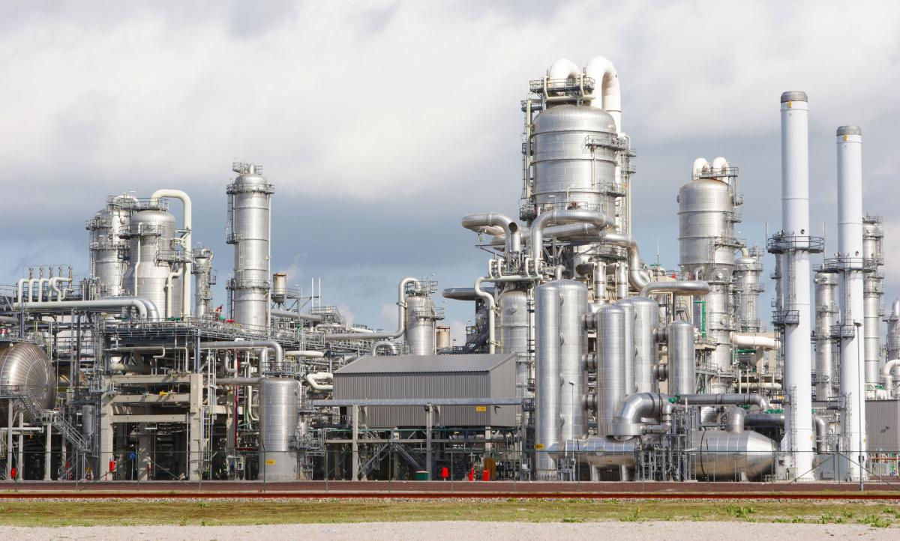
About BIT Mesra
Facilities
Importance & Scope of the
Programme
The Birla Institute of Technology, Mesra, Ranchi was established in 1955 by the philanthropist and industrialist Late Shri B.M. Birla with a vision to provide quality learning and dissemination of knowledge. The institute today offer undergraduate, postgraduate as well as doctoral level programmes in diverse disciplines of science and Engineering
CAE: ASPEN PLUS •FLUENT •Poly Flow •MATLAB •Mold FlowSoftware: Flow, Stress, Warp and Cool •Acclerys Material Studio: Synthia, Blend, COMPASS, Amorphous Cell, Discover, MesoDyn, DPD•CATIA •Autodesk Inventor •Pro-engineer •ANSYS •Virtual Laboratory
Paulson Training Modules, Injection Moulding, Single Screw Extrusion, Compounding with Twin Screw Extrusion, and SIMTECH, etc.
Mass transfer, Mechanical Operations, Heat Transfer , Fluid flow, Reaction Engg., Fuel Technology, Process Control Lab., Polymer Processing Facilities etc.
At the present time, Process Simulations are the fundamental steps to design and develop a chemical process plant. Suitable description of the performance of the various unit operations of the plant should be made and integrated, to understand the mutual interferences both under steady state conditions and under unsteady state conditions. Process simulation tools are helpful to compute both situations. The stationary case can be simulated with package dealing with material and energy balance applied to each case needs dynamic modeling to describe the time- dependent evolution of the system.
Thus the main aim of this workshop is to provide well knit training on simulating vital chemical process under steady & unsteady state conditions, in order to design & develop the chemical process & product. The technocrats & academic participating will be put through enriching technical session from primitive property predictions to advanced industrial flow sheeting simulations. The TEQIP workshop is proposed diversified chemical field simulation so that the participants of different disciplines can take benefits of chemical process simulations.
About Department
Registration Details:
The Department was established in 1994 and currently offers two undergraduate programmes in B.E. (Chemical Engineering) & B.E. (Chemical Engineering–Plastics & Polymer) and two postgraduate programmes in M.E. (Chemical Engineering) & I.MSc. (Food Technology). The Department also provides facilities for doctoral research in the fields of Chemical Engineering, Polymer Science-Technology and Food Science- Technology . The Department received national recognition by winning the Gold Trophy for Plasticon Award 2012 in the category of Best Educational Institution Contributing to Plastics at the 8th International Plastics Exhibition and Conference, New Delhi.
Important Dates:
Last date for registration: 04.05.2018
Registration Fees:
Faculty Members: Rs.5000/- (including GST)
Research Scholar and P.G. Students: Rs. 3000/-(Including GST)
Industry Participants: Rs. 6000/-
Travelling, lodging, boarding and other expenses will have to be borne by the participants. Accommodation will be provided on request in Institute Guest House/Hostels and hostels depending upon availability.
The course fee includes Registration kit, High tea, snacks, lunch, dinner( for outside Participants only) and certificate, registration fee will be accepted through NEFT with details (of SBI BIT) given Below.
Account number: 37354860062
IFSC code: SBIN0018056
Accommodation for external participants is available in Institute Guest Houses/Hostels.
The filed registration form (hard/scanned copy) along with the copy of Money Transfer to be sent to :
Course Content
The workshop aims to cover the following topics:
Aspen Simulation: introduction to Aspen Software, Simulation of single unit operations-Pressure Changes, Flash Drum, Distillation columns, Reactors etc.
ASPEN Industrial Process Simulation: Industrial Flow Sheeting & Process Simulation of Conventional/In conventional chemicals (eg. Complex-amine reactions, chemical loop combustion etc.)
ASPEN Tool Analysis: Sensitivity Tool, Design Spec, Optimization Tool, Cost Analysis.
MATLAB SIMULINK: Unsteady state process simulations-Lumped & Distributed parameters model.
CFD: Classical flow Phenomenon.
Molecular Dynamics: Atomic/molecular simulations-phenomena associated with density, phased transition point and diffusion of Lennard-Jones system
About the Location and Travel
Birla Institute Technology (BIT) is located at Mesra, about 16 Km from Ranchi, the state-capital of Jharkhand. Ranchi is well connected to rest of the country through regular flight from major airports as well as through well developed rail and road networks. The BIT ‘more’ on National Highway-33 is well known landmark from where a tree-lined avenue leads one to the grounds that are always abuzz with young voices. The sprawling campus is located in a picturesque 780 acres setting at the confluence of the rivers Jumar and Subarnarekha.
For Correspondence:
Prof. (Mrs.) S. Goswami
Email- chemical@bitmesra.ac.in
Phone: 9431991789
Dr. R.R. Pandiyan
Email. raghuchemraj@gmail.com,
raghu@bitmesra.ac.in
Phone No. 8002486897
Who Should Attend?
Faculty members of Engineering colleges, PG students, research scholars and practicing engineers with active interest in the field can apply.

